Slide 1
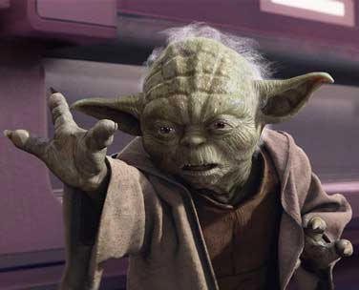

May the Force
Be With You!

Slide 2
Learning Objectives
I can recognize forces that affect the motion of matter.
I can compare balanced and unbalanced forces.
I can determine the net force on an object.

Slide 3
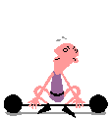
What is a force?
A force is a push or pull that causes an object to move, stop, or change direction
In physics a force is anything that makes an object accelerate
If an object is stationary, it won’t start moving without a force.

Slide 4
Force
Forces come in pairs
Forces have a magnitude and a direction
Force is a vector quantity
Magnitude: 5N
Direction: north (up)
5N, north (up)

Slide 5
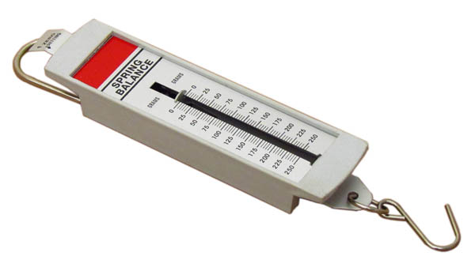
Force Measurement and Units
SI unit for force is the Newton
A Newton is a force that causes a 1kg mass to accelerate at a rate of 1m/s/s.
1 N (Newton) = 1 kg * m/s/s
We use a spring scale to measure force.

Slide 6
Combining Forces
Net Force – The overall force acting on an object after all forces are combined.
- Forces in the same direction we add them.
- Forces in opposite directions you subtract them.
10N
10N
Net Force = 10N
+
=
10N
7N
Net Force = 3N
-
=

Slide 7
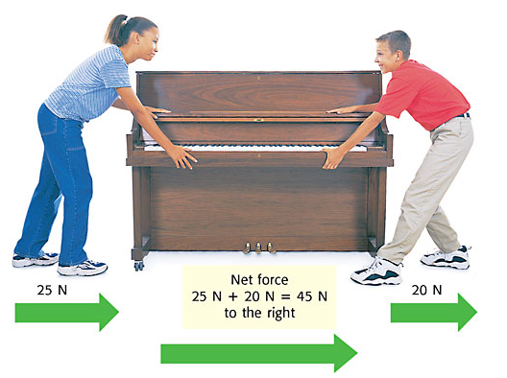
Forces in the Same Direction
When forces are applied in the same direction, they are added to determine the size of the net force.

Slide 8
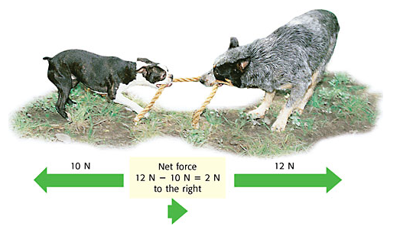
Forces in Different Directions
When two forces act in opposite directions, you subtract the smaller force from the larger force to determine the net force.
The net force will be in the same direction as the larger force.

Slide 9
Combining Forces at Right Angles
Use the Pythagorean Theorem.
- a² + b² ⁼ c².
- Can only use if adding only 2 vectors that make a right angle.
c
hypotenuse
b
a

Slide 10
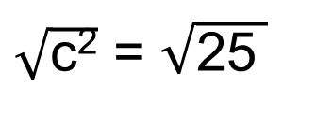
Combining Forces at Right Angles
Use the Pythagorean Theorem - a² + b² ⁼ c².
- ex. What is the resultant force if you have a force 3N South and another force 4N West and show the diagram.
a² + b² ⁼ c²
4N West
c² = 4² + 3²
c² = 16 + 9
3N
South
c² = 25
5N
South West
$\sqrt{\text{c}\text{2}}$ = $\sqrt{\text{25} }$
c = 5 N SW

Slide 11
Balanced and Unbalanced Forces
Forces occur in pairs and they can be either balanced or unbalanced

Slide 12
Balanced Forces: The forces in each direction are “equal”.
  If more than one force is present, it does not have to cause an acceleration on an object.
  If another force “balances” the first out, there will be no acceleration at all.
Think: If both guys (who weight the same)
pull on a rope in opposite directions, with
an equal amount of force, how much will they move?

Slide 13


Balanced Forces
Balanced forces do not cause a change in motion
They are equal in size and opposite in direction
The net force is 0

Slide 14
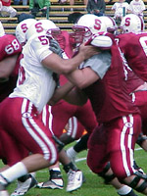
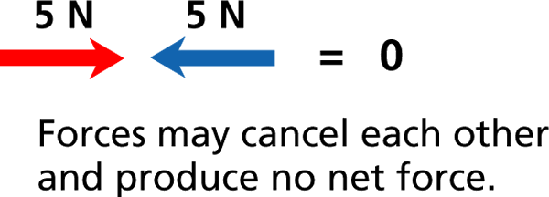

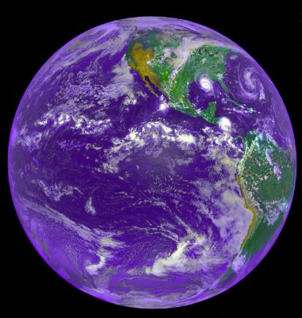
Example:
Ground pushes up
Gravity pulls down
Gravity pulls down on you…
The ground pushes back up…
THIS KEEPS YOU WHERE YOU ARE!
If these football players push
on each other equally as hard,
will either one move?

Slide 15
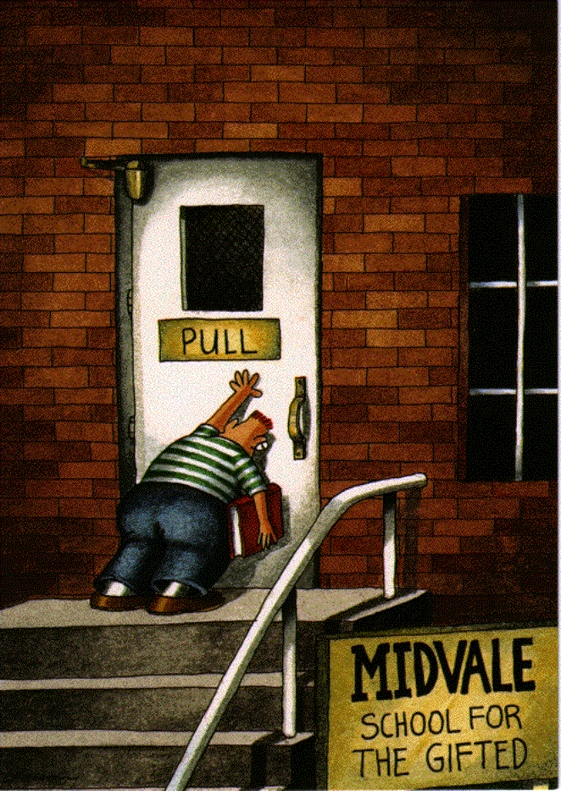
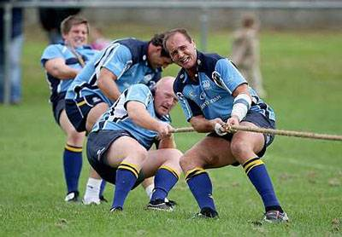
More Balanced Forces…
5 N
5 N
5 N
5 N
Forces may cancel each other and produce no movement
  =No Acceleration!

Slide 16


“Unbalanced” Forces
If the multiple forces acting at one time are not balanced out (equal), then acceleration can/will occur on the object!
Kicking the ball causes it to move
quickly in a different direction
If one side of the scale has more mass,
then gravity will accelerate it down!

Slide 17
Unbalanced Forces
An unbalanced force always causes a change in motion
The net force is greater than 0
When unbalanced forces act in opposite directions you can find the net force
  Net force
    Magnitude
      The difference between the two forces
    Direction
      Direction of the largest force

Slide 18

Unbalanced Forces
3 N, right – 6 N, left = 3N, left

Slide 19

Unbalanced Forces
4 N, left – 10 N, right =
6N, right

Slide 20
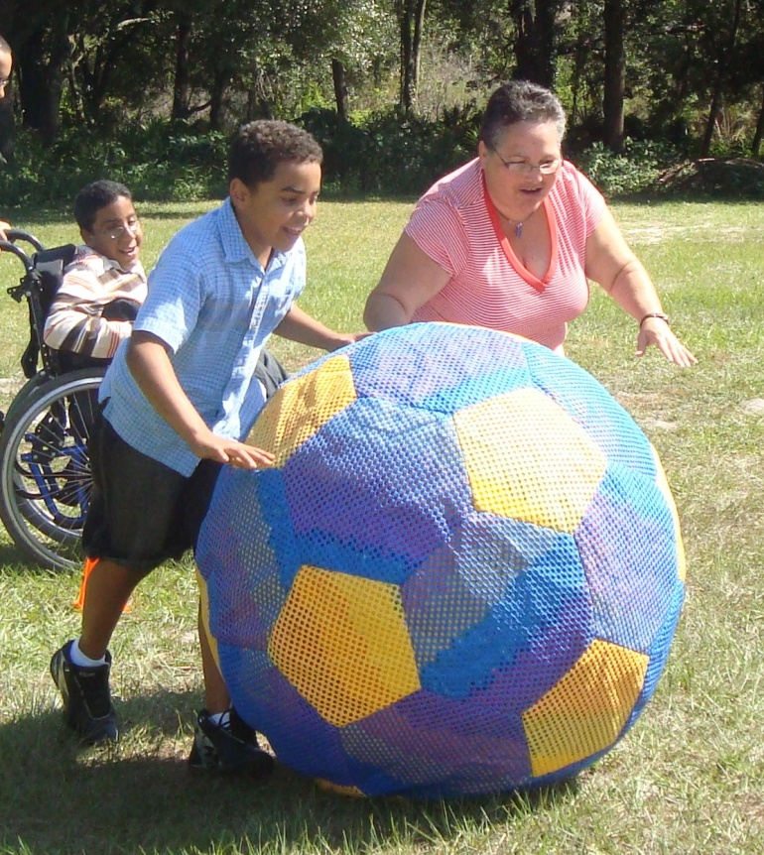

Unbalanced Forces
5 N, right + 10 N, right =
15N, right

Slide 21
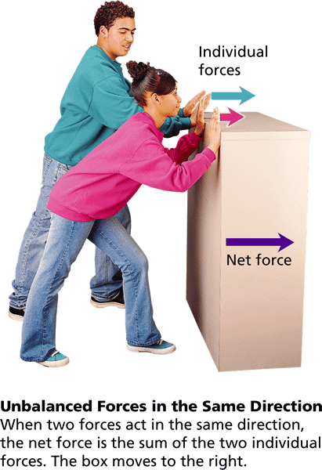
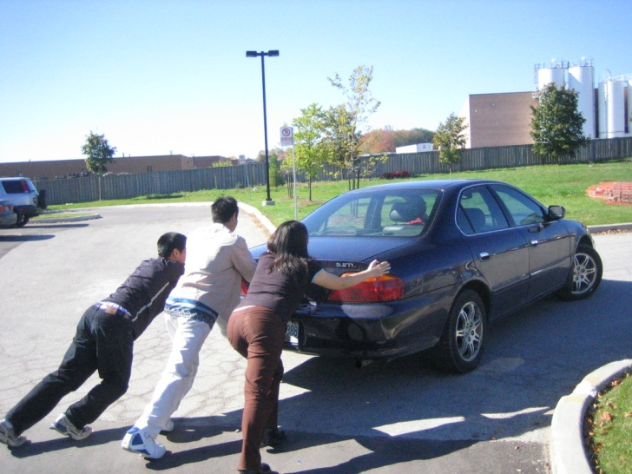
Unbalanced Forces
Cause Acceleration
Multiple forces can combine to move an object that has too much inertia for one force alone. The forces “add together”!
Adding Forces:
Random Object
5 N
What you just
saw was like
two people
pushing on the
same box.
5 N
Notice that all the new forces are pointed in the same direction, and they add together! So, instead of only 5N of force pushing the object; now there are 10 N of force pushing!
All by himself, one person might not be able to push a car. But with extra friends pushing, it becomes much easier! The forces add together.

Slide 22
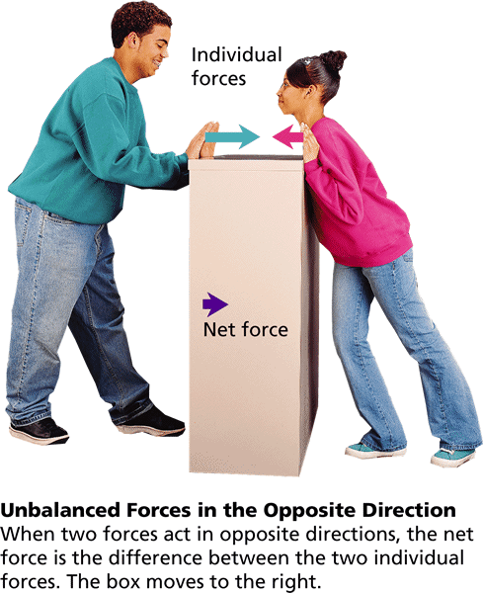
Unbalanced Forces
Cause Acceleration
If forces are not equal and are acting in opposite directions, a negative acceleration can/will occur. The forces will subtract from each other!
Subtracting Forces:
Object
5 N
5 N
5 N
Notice that the forces are “unequal” and pointed in the opposite direction. So they are “unbalanced” and work against each other – or one partially cancels the other.
The end result is that the forces on the left
are slowed down by the single force on the right

Slide 23
Review Balanced Forces
 | Balanced Push i.e. Pushing a Car | No Acceleration or change in motion | Net Force = 0
 | Balanced Pull i.e. Tug-o-war | No Acceleration or change in motion | Net Force = 0
10N
10N
10N
10N

Slide 24
Review Un-Balanced Forces
Add Together | Un-Balanced Same Direction | Faster Acceleration | Net Force > 0
Subtract from each other | Un-Balanced Opposite Direction | Slower Acceleration | Net Force > 0
10N
10N
10N
10N
10N

